Slide 1

FINNISH HEALTH DATA HACKATHON
Patient Access Track
December 15, 2025
Notes:
Remember the recording!

Slide 2







Slide 3
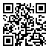
AGENDA
What Is the Finnish Health Data Hackathon?
Patient Access Track
Finnish SMART IG
City of Helsinki / Apotti / Epic
Kanta
xShare
Identity Wallets & NCP
fhir.fi/hackathon

Slide 4
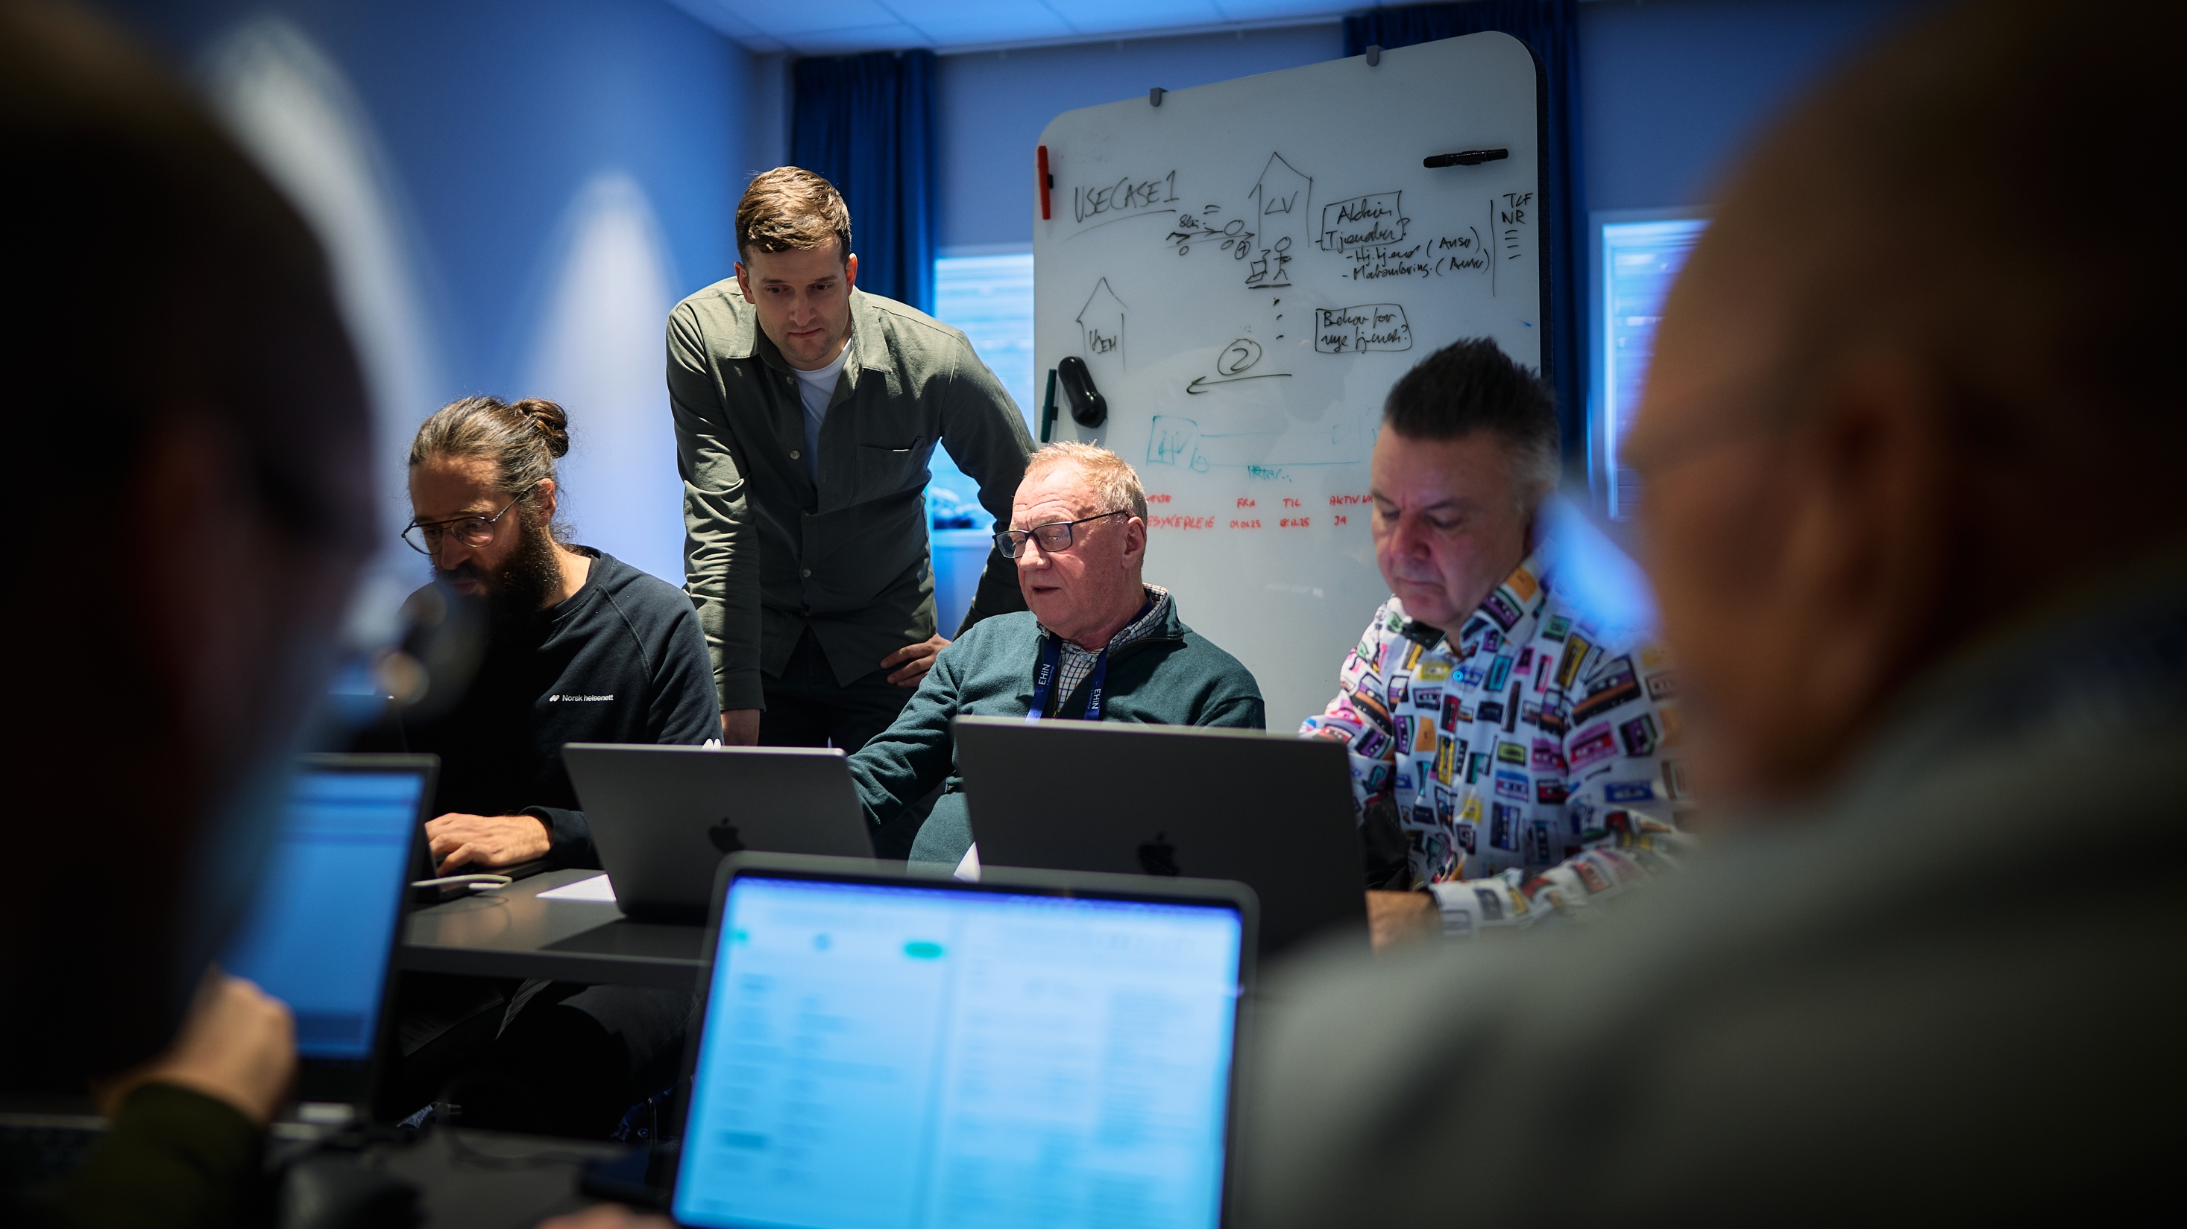
©️ Still Words Photography clients.stillwords.com/EHiN2025
Notes:
Get together, plug systems together, exchange data, see what works and what does not.
Show what’s possible to achieve with the technologies.

Slide 5
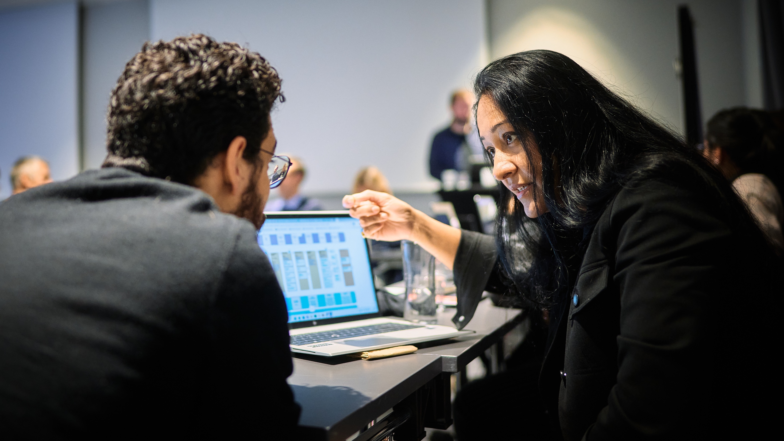
©️ Still Words Photography clients.stillwords.com/EHiN2025
Notes:
When something does not work, discuss it.
Talk about the specifications. This is how I interpret it, and why.
Give feedback – it is possible to interpret this part in this and this way.
It’s possible to implement this part in this and that way.
Specs always aim to be clear and unambiguous. It’s hard.

Slide 6

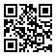
fhir.fi/hackathon
Notes:
This event is part of a larger series of hackathons

Slide 7
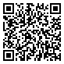
HL7 Finland 30 Years Symposium
Monday, 19 January 2026
Same premises as the hackathon
Requires different registration!
Draft agenda:
9.30-10.00 Coffee 10.00-12.00 Finnish sessions 12.00-13.00 Lunch 13.00-16.00 International sessions 16.00- Networking and drinks
www.hl7.fi/kokoukset-ja-tapahtumat/hl7-finland-30th-anniversary-symposium/

Slide 8
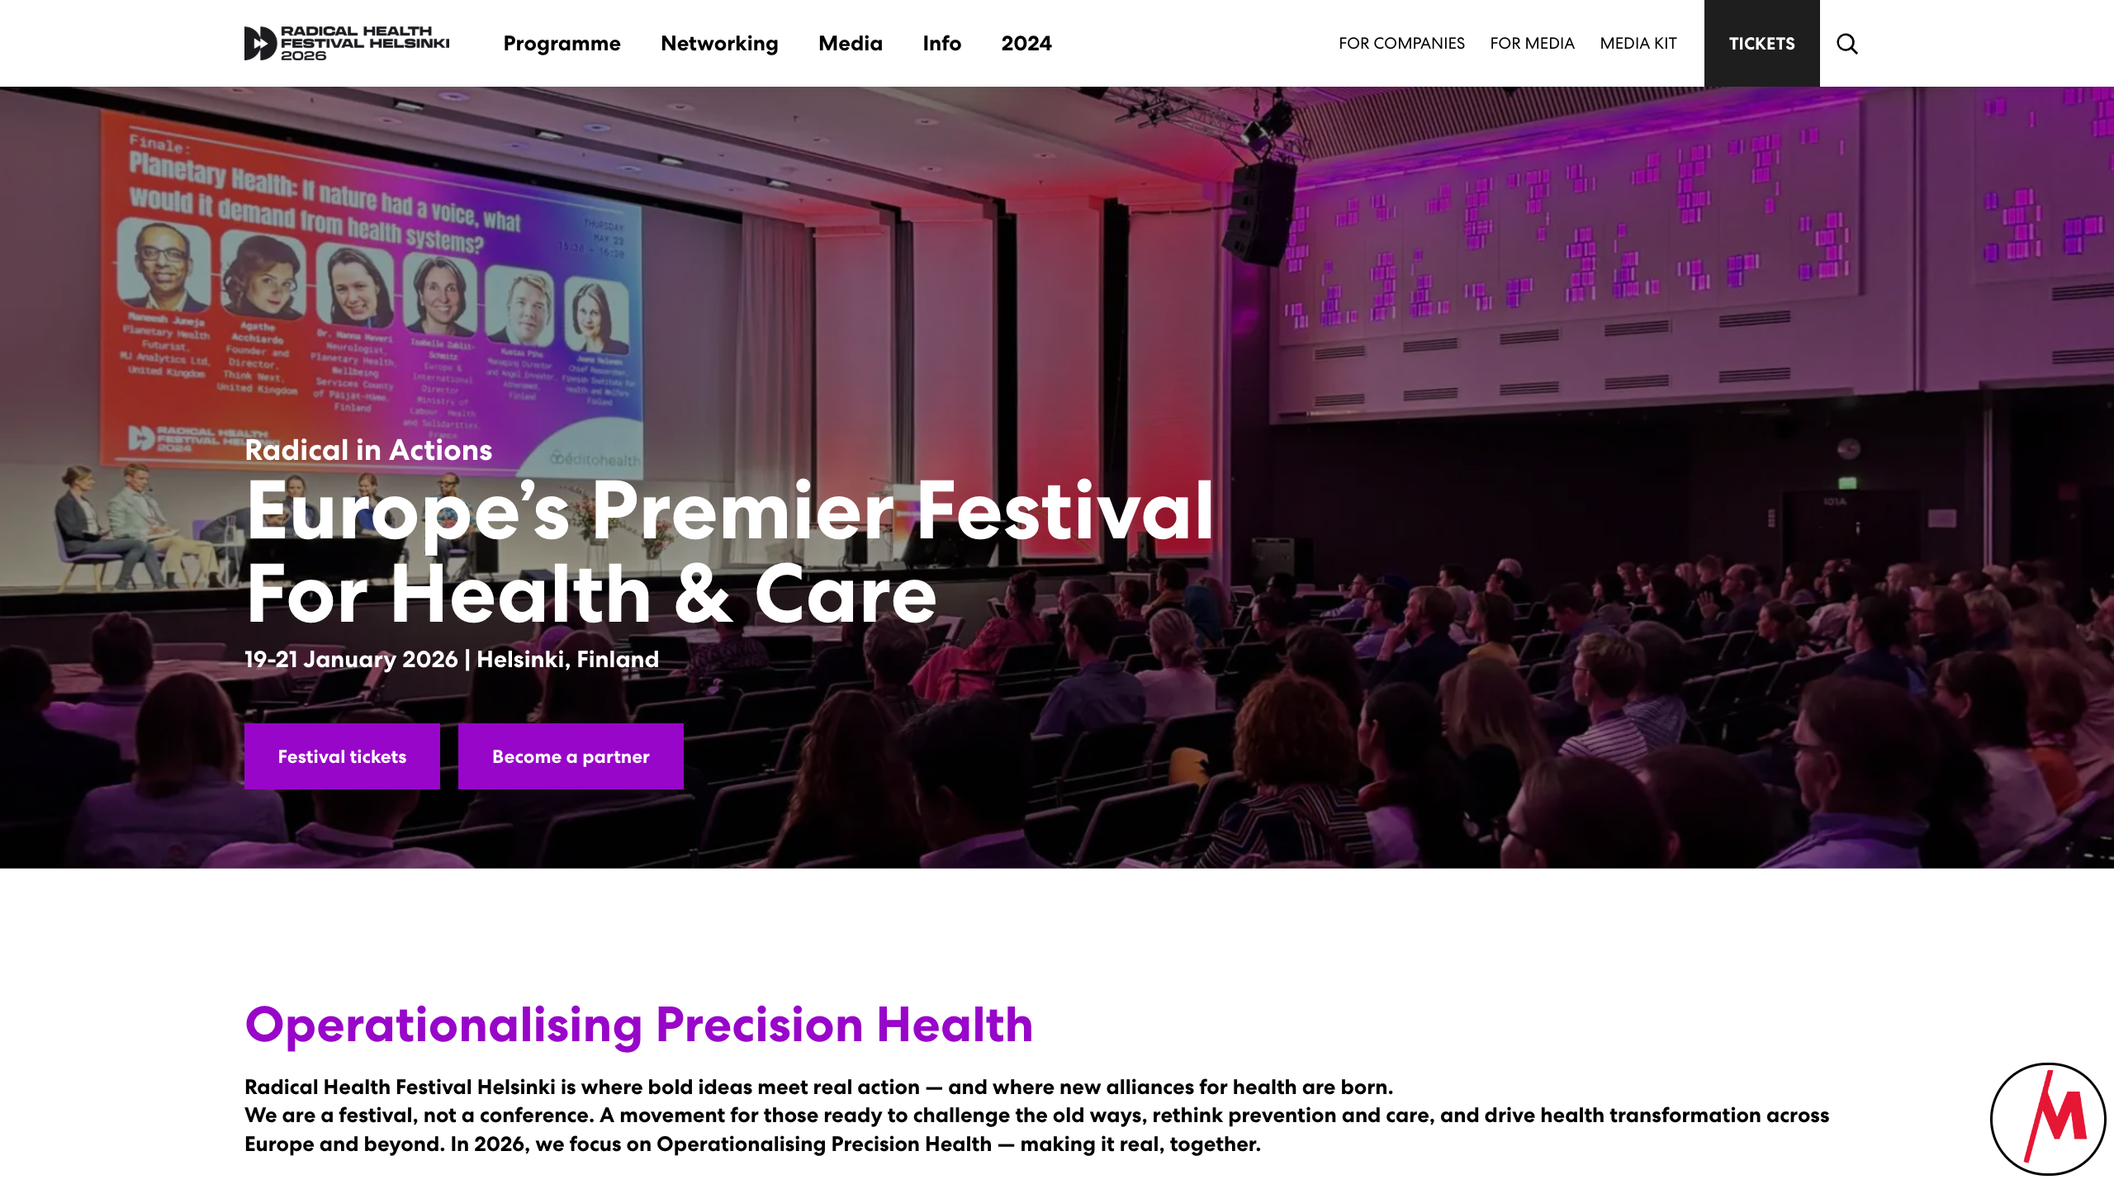
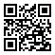
radicalhealthfest.com

Slide 9
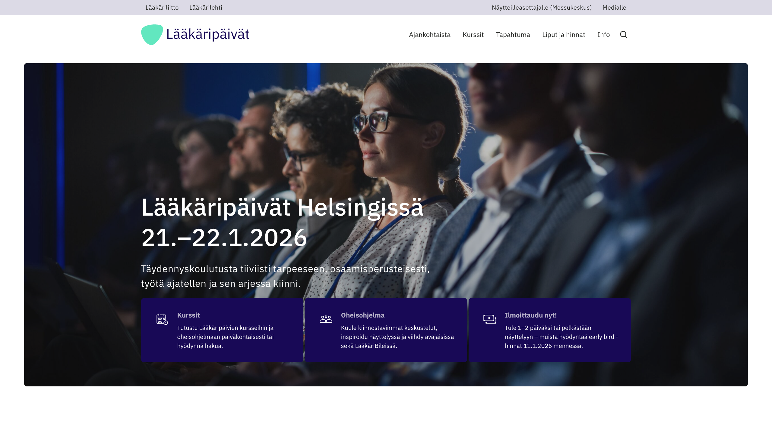
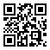
laakaripaivat.fi

Slide 10
When & Where
Monday, January 19, 2026, starting at 9:00 EEST
Some tracks continue on Tuesday, January 20, 2026
Results presented on Wednesday, January 21, 2026

Slide 11
Participation
Register in advance
No costs involved!
Notes:
for the main hackathon on Monday
Radical Health Festival and Lääkäripäivät require a paid registration

Slide 12
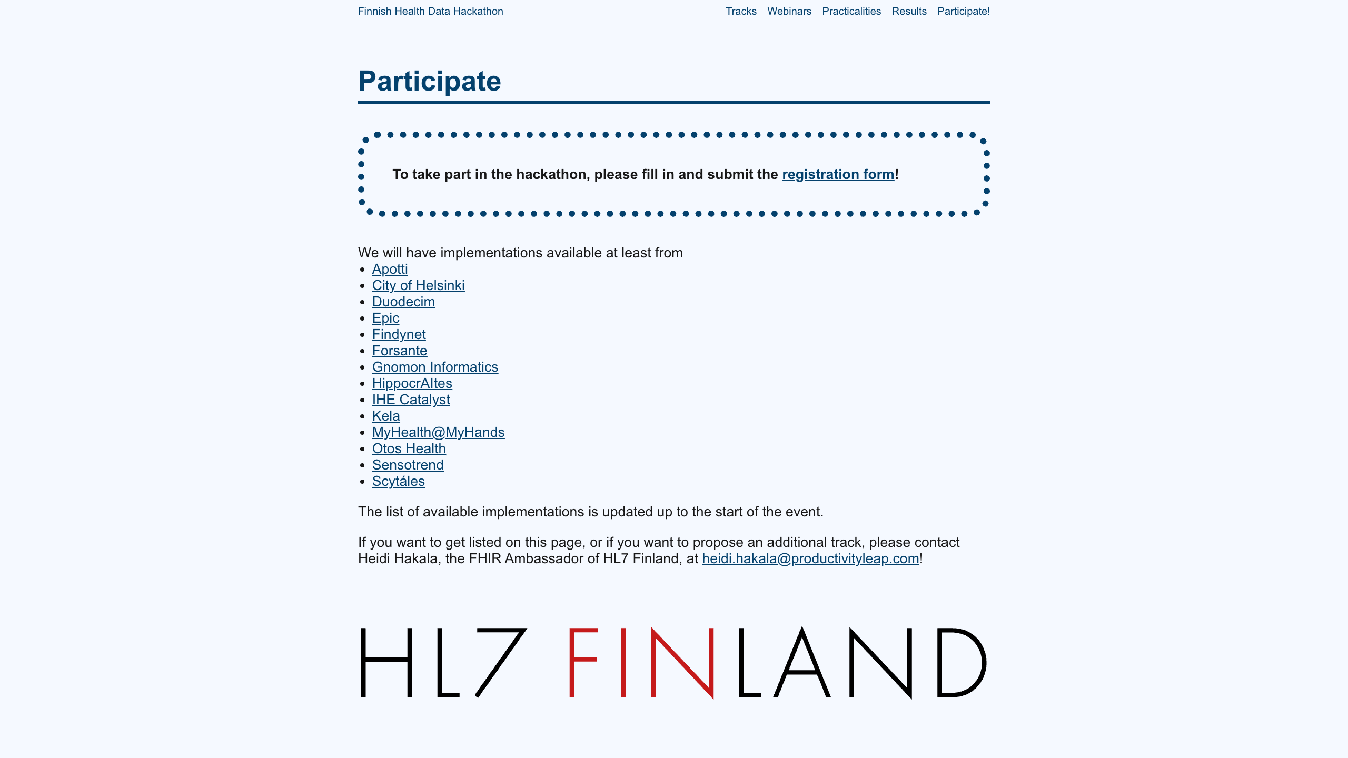

Slide 13
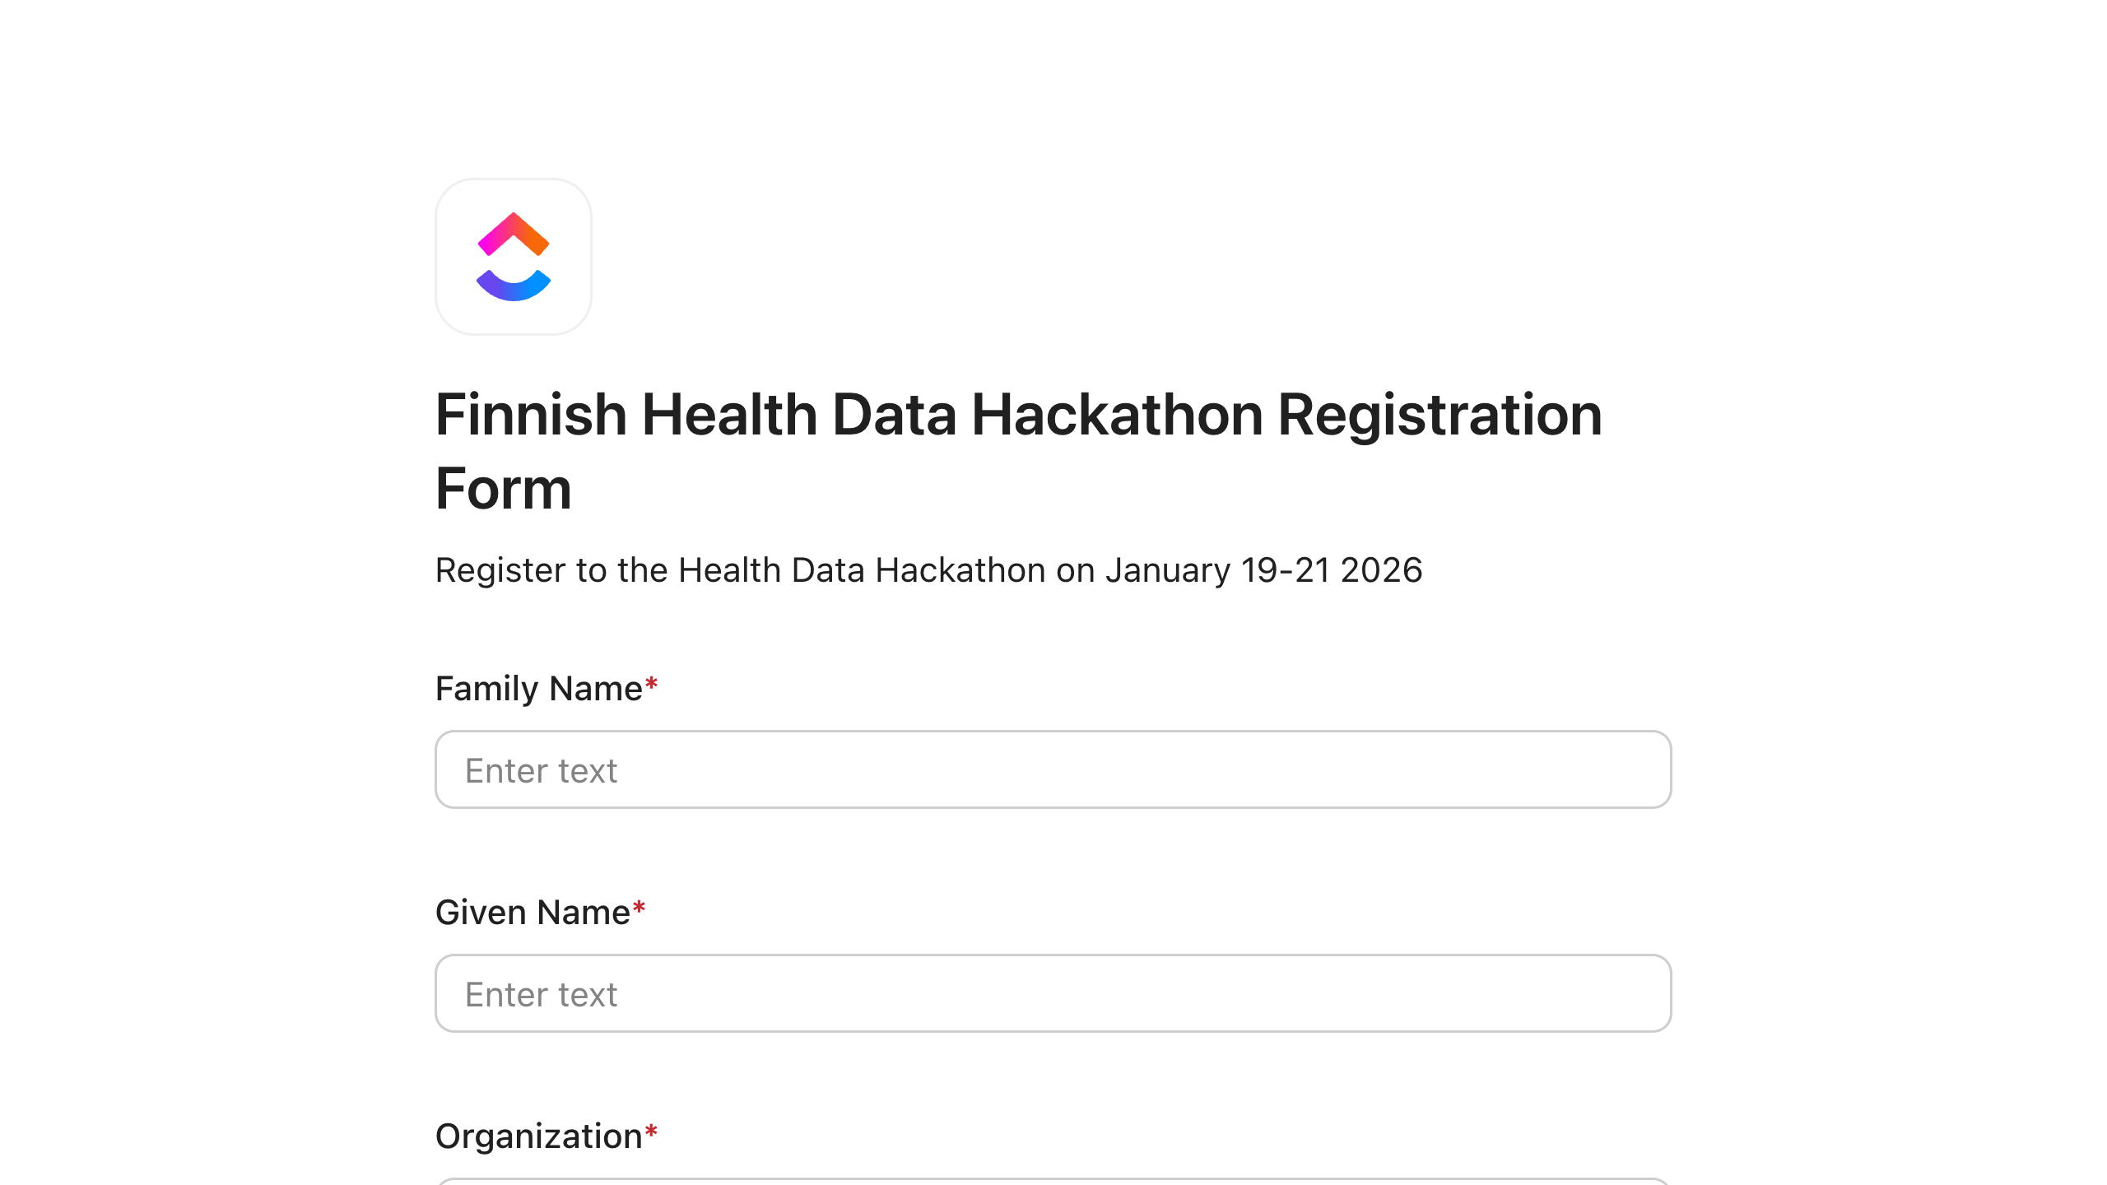

Slide 14
Q&A
Finnish Health Data Hackathon

Slide 15
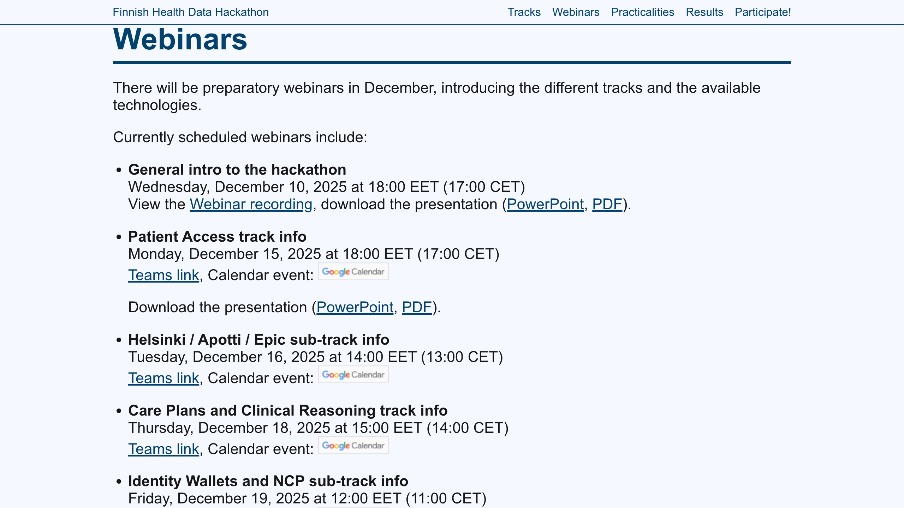

Slide 16
Topics
Patient Access track of the Finnish Health Data Hackathon

Slide 17
Finnish SMART IG
Finnish Implementation Guide for SMART App Launch
Published by HL7 Finland
Looking for implementations and feedback
Also national adaptations (https://hl7.dk/fhir/smart/) and harmonization!

Slide 18
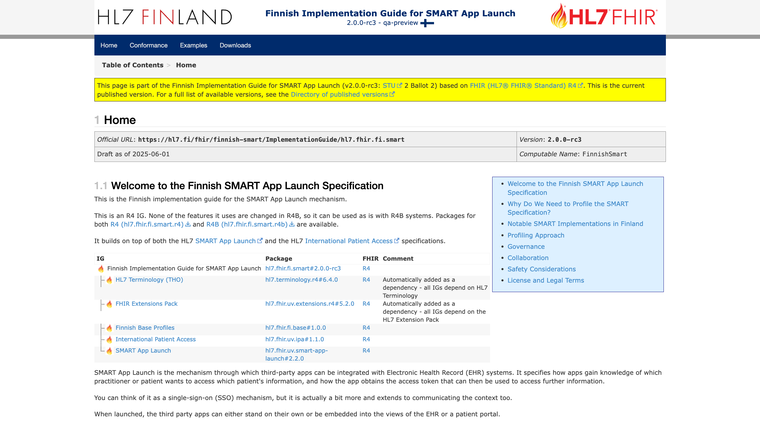
Finnish SMART IG

Slide 19
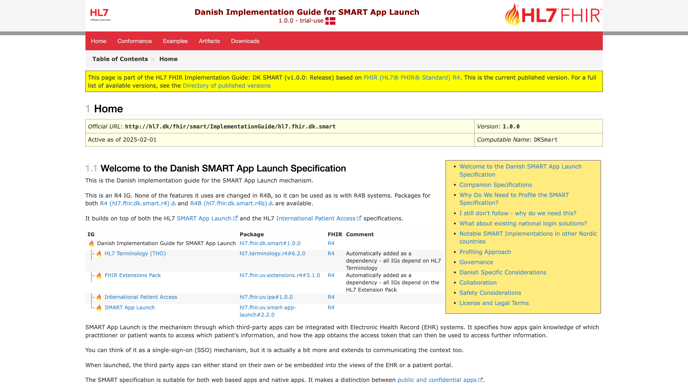
Finnish SMART IG

Slide 20
City of Helsinki / Apotti / Epic
A challenge from the City of Helsinki?
Apotti is a local Epic installation
Maisa, a localized MyChart patient portal and app
Notes:
Challenge
Separate webinar coming up
Apotti Ecosystem
Fhir.epic.com
Maisa

Slide 21
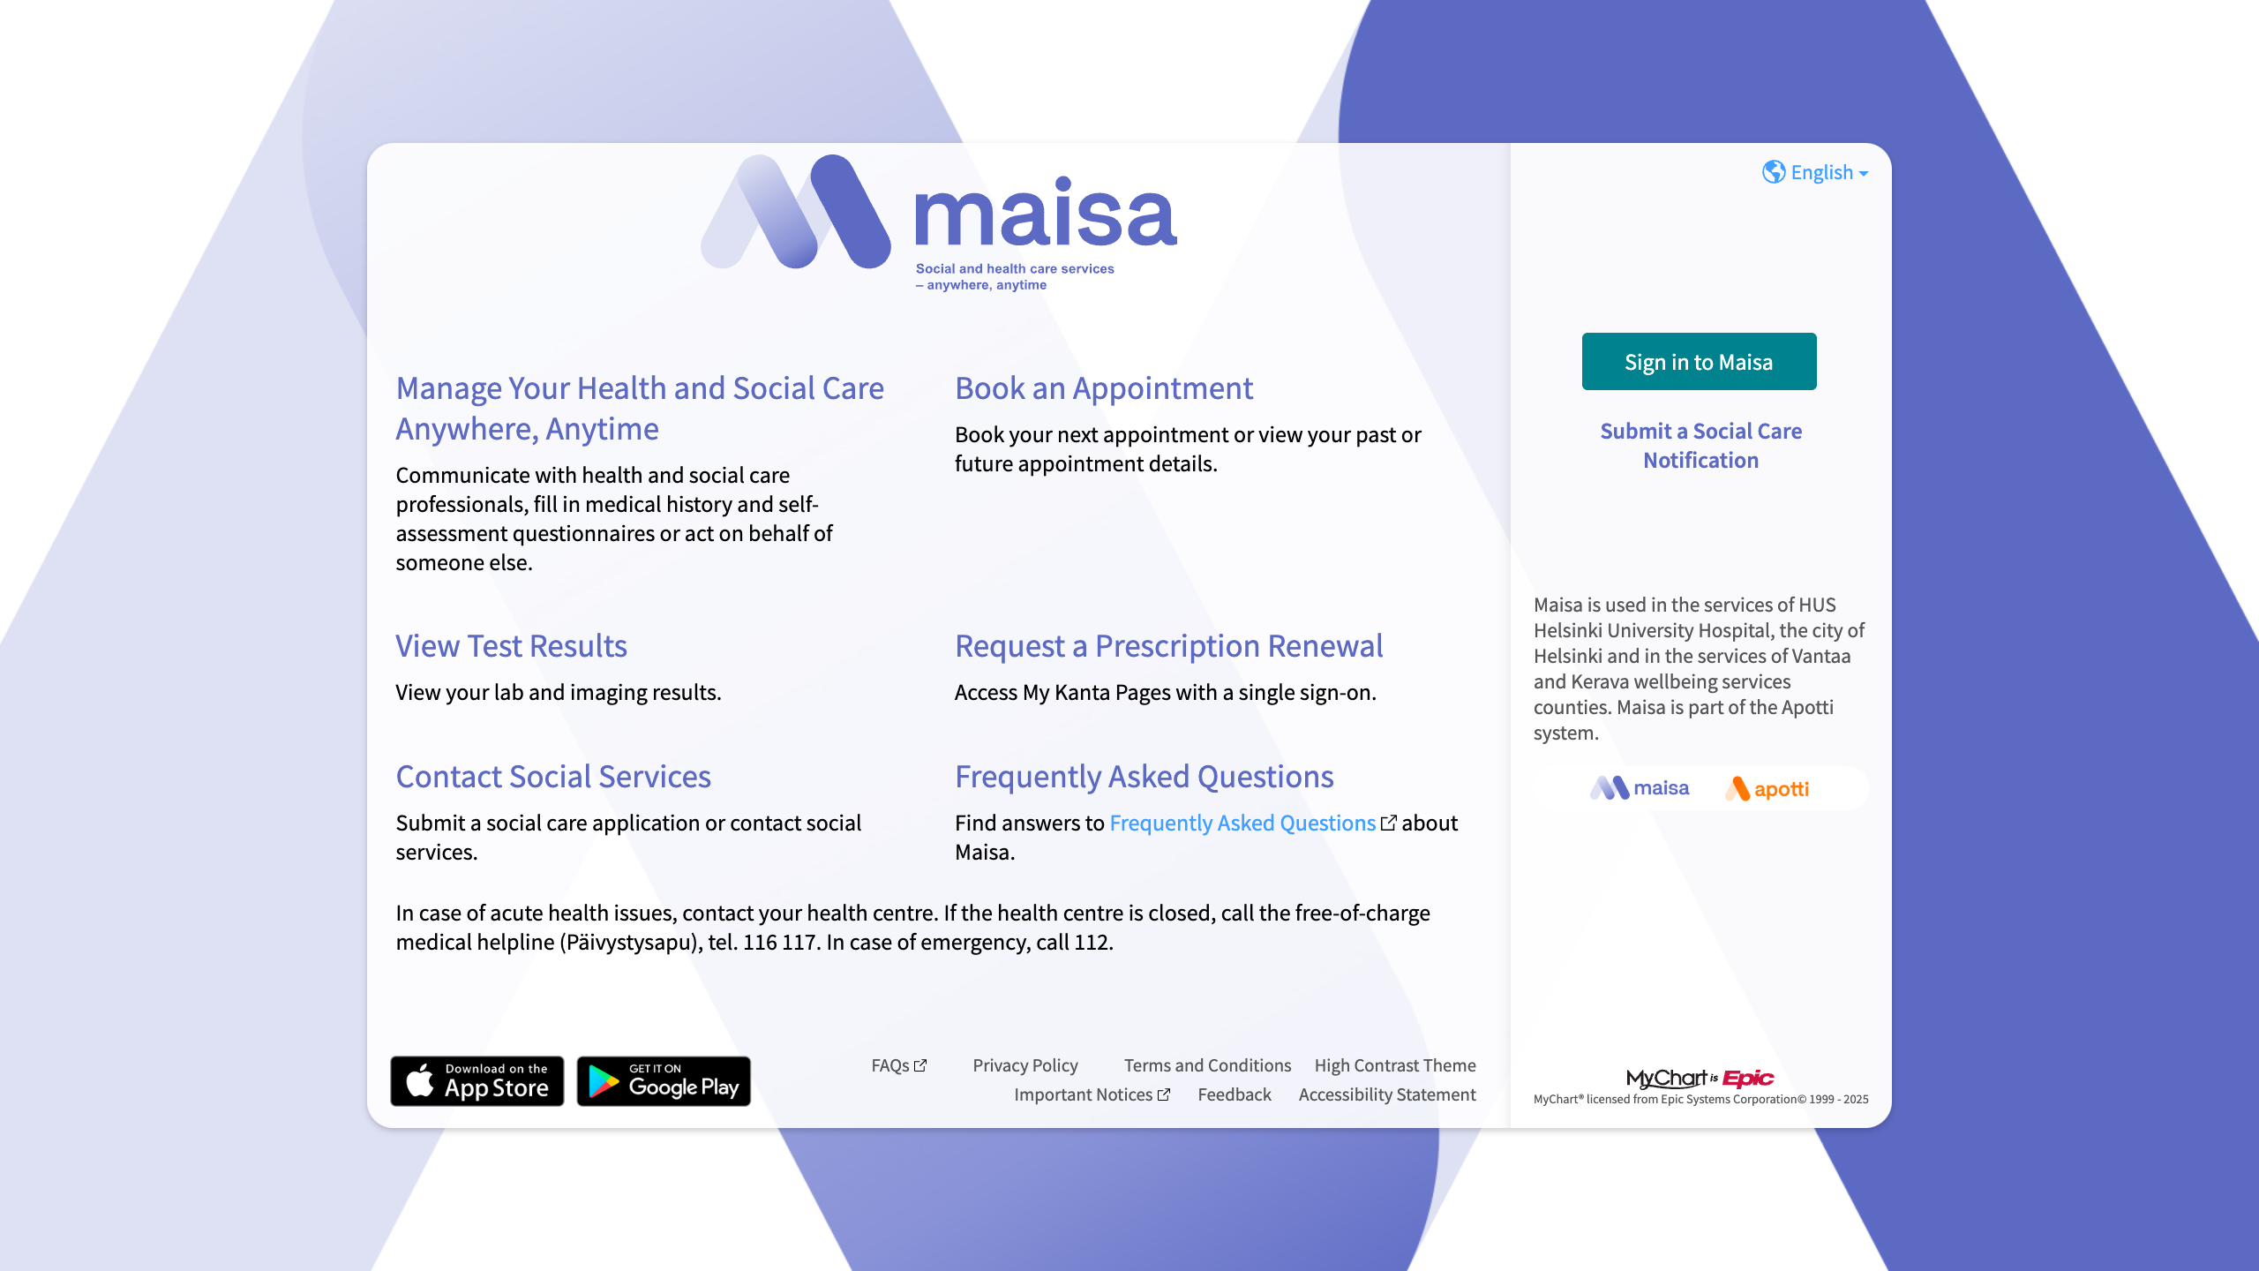

Slide 22
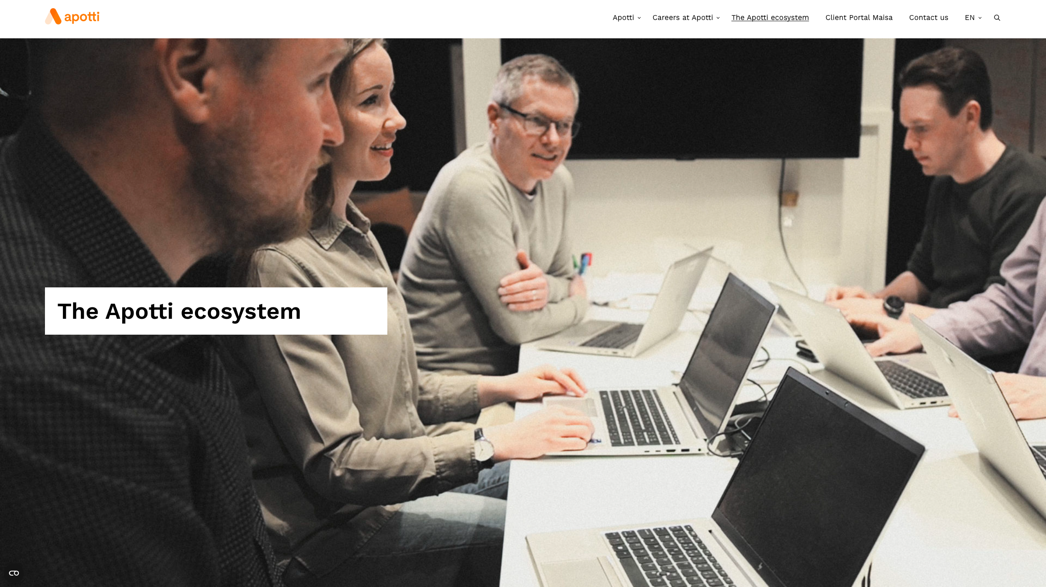

Slide 23
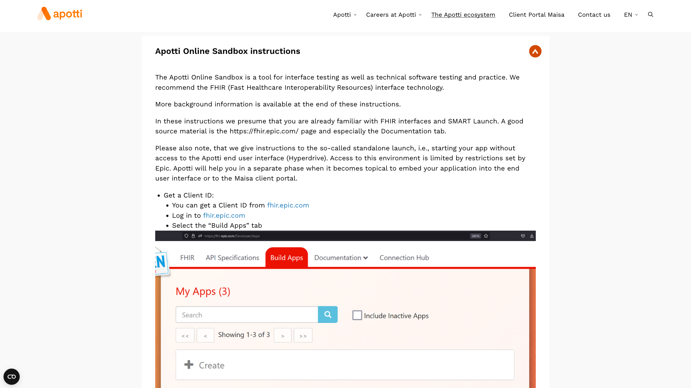

Slide 24
City of Helsinki / Apotti / Epic
https://www.apotti.fi/en/the-apotti-ecosystem/
https://fhir.epic.com/ (worth registering in advance!)
https://hl7.fi/fhir/finnish-smart/AuditEvent-apotti-ehr-launch-by-practitioner.html
A separate webinar tomorrow!
Tuesday, December 16, 2025 at 14:00 EET (13:00 CET)
See hackathon website for details!
Notes:
Challenge
Separate webinar coming up
Apotti Ecosystem
Fhir.epic.com
Maisa

Slide 25
Kanta APIs
Wellbeing Applications Interface to the Kanta Patient Data Repository
Patient acces to structured clinical data
CDA data served through a FHIR API
https://www.kanta.fi/en/system-developers/hyvinvointisovellusten-rajapinta
Personal Health Record (PHR)
Platform for data from patients
FHIR server, FHIR profiles and API’s
https://www.kanta.fi/en/system-developers/kanta-phr
Developer support being ramped down, due to upcoming changes
Notes:
Patient Access API
Personal Health Record

Slide 26
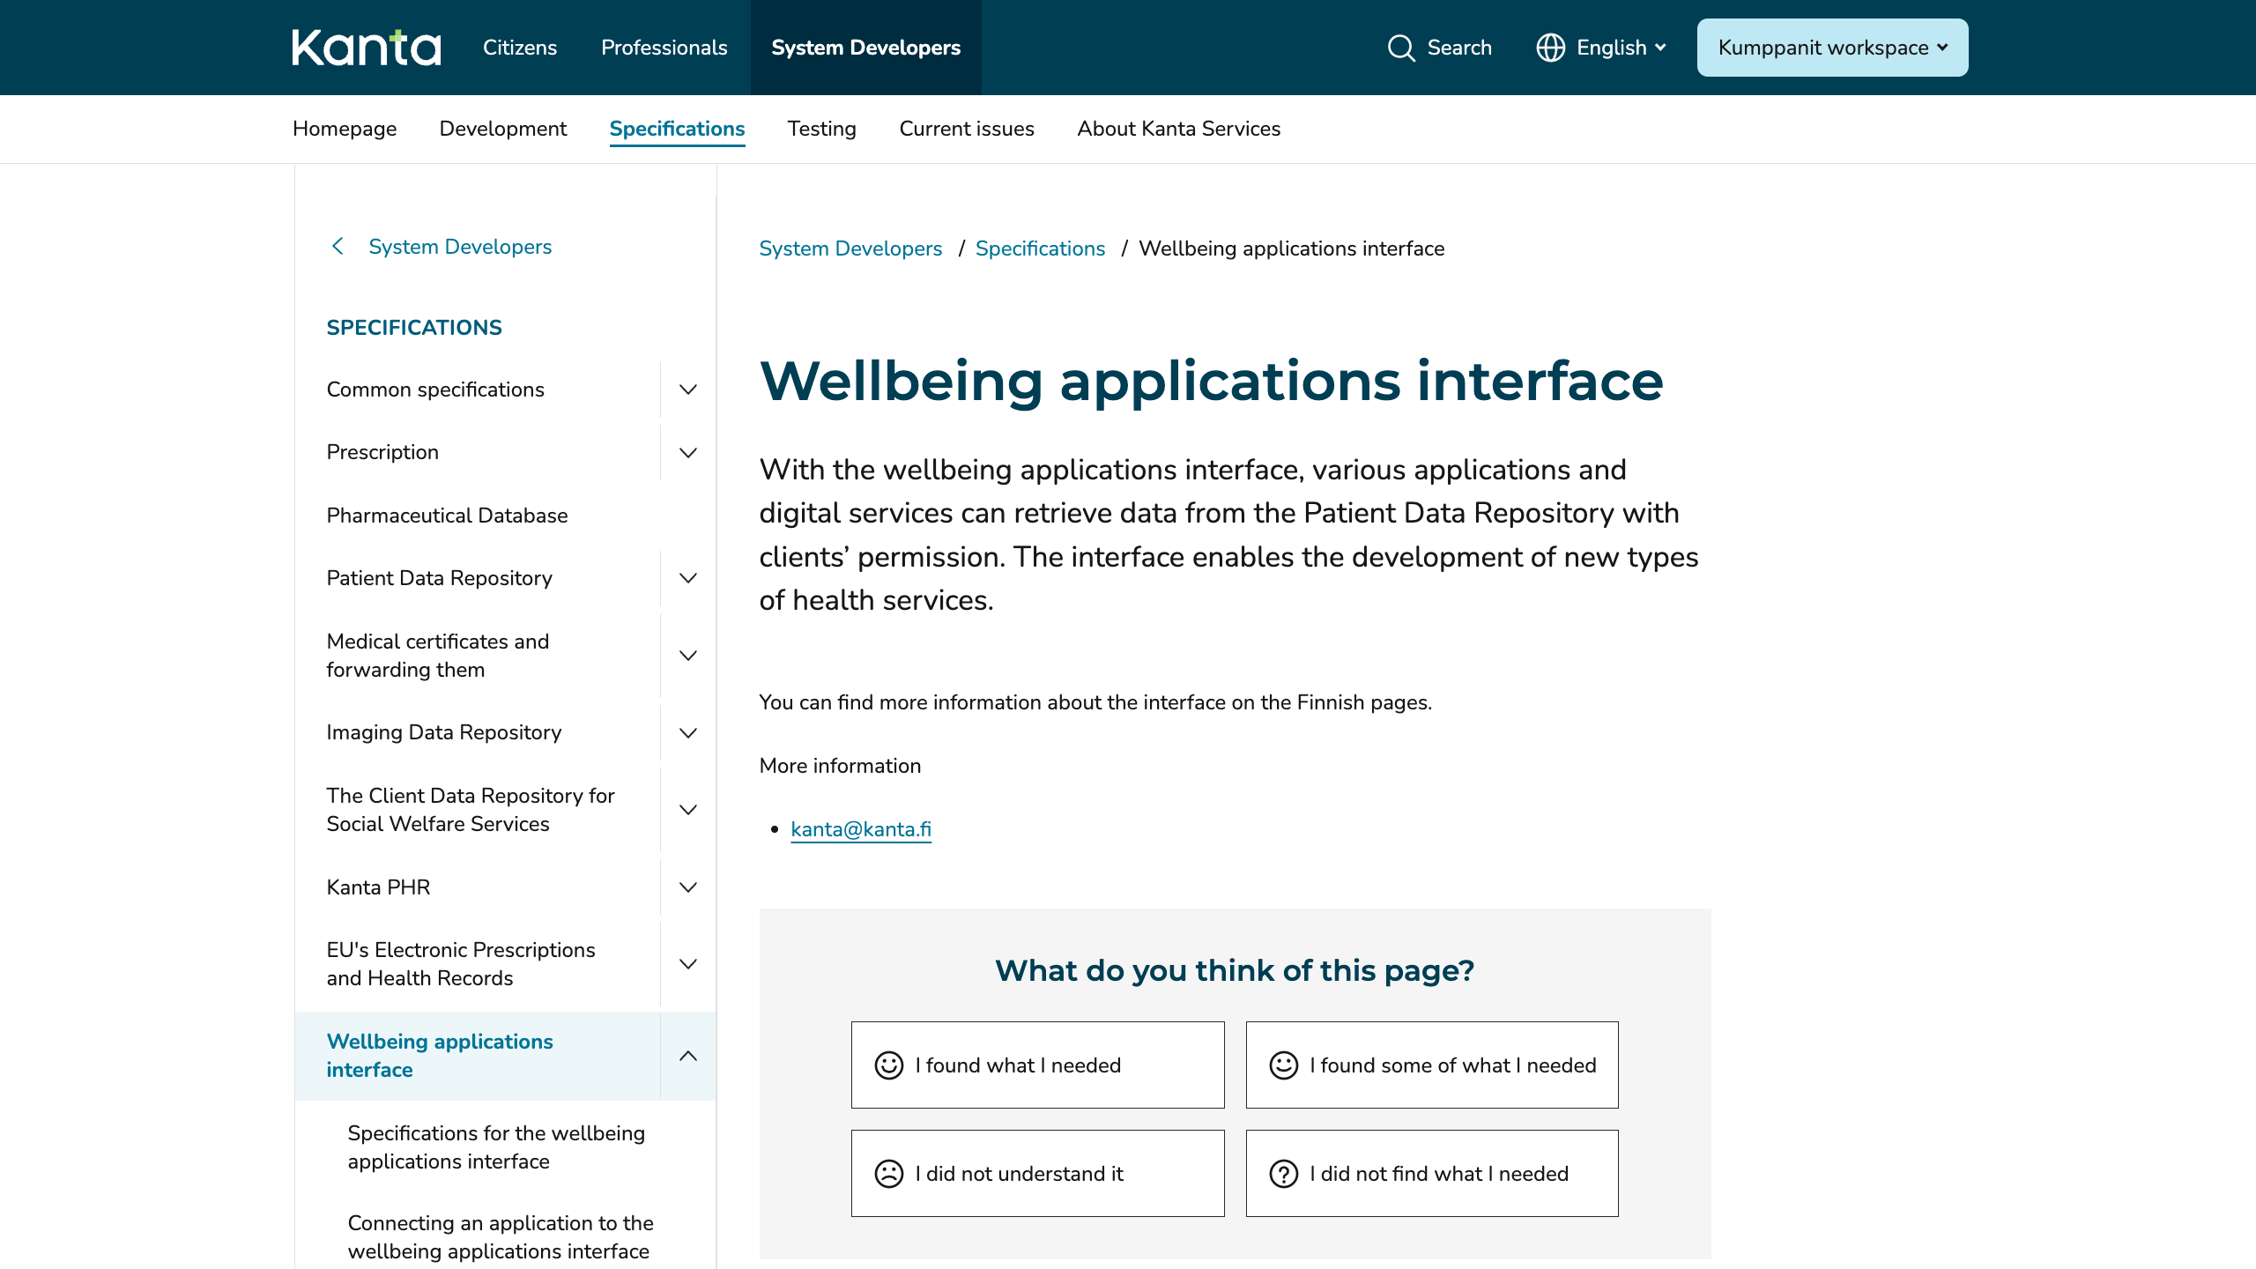
Kanta APIs
Notes:
Patient Access API
Personal Health Record

Slide 27
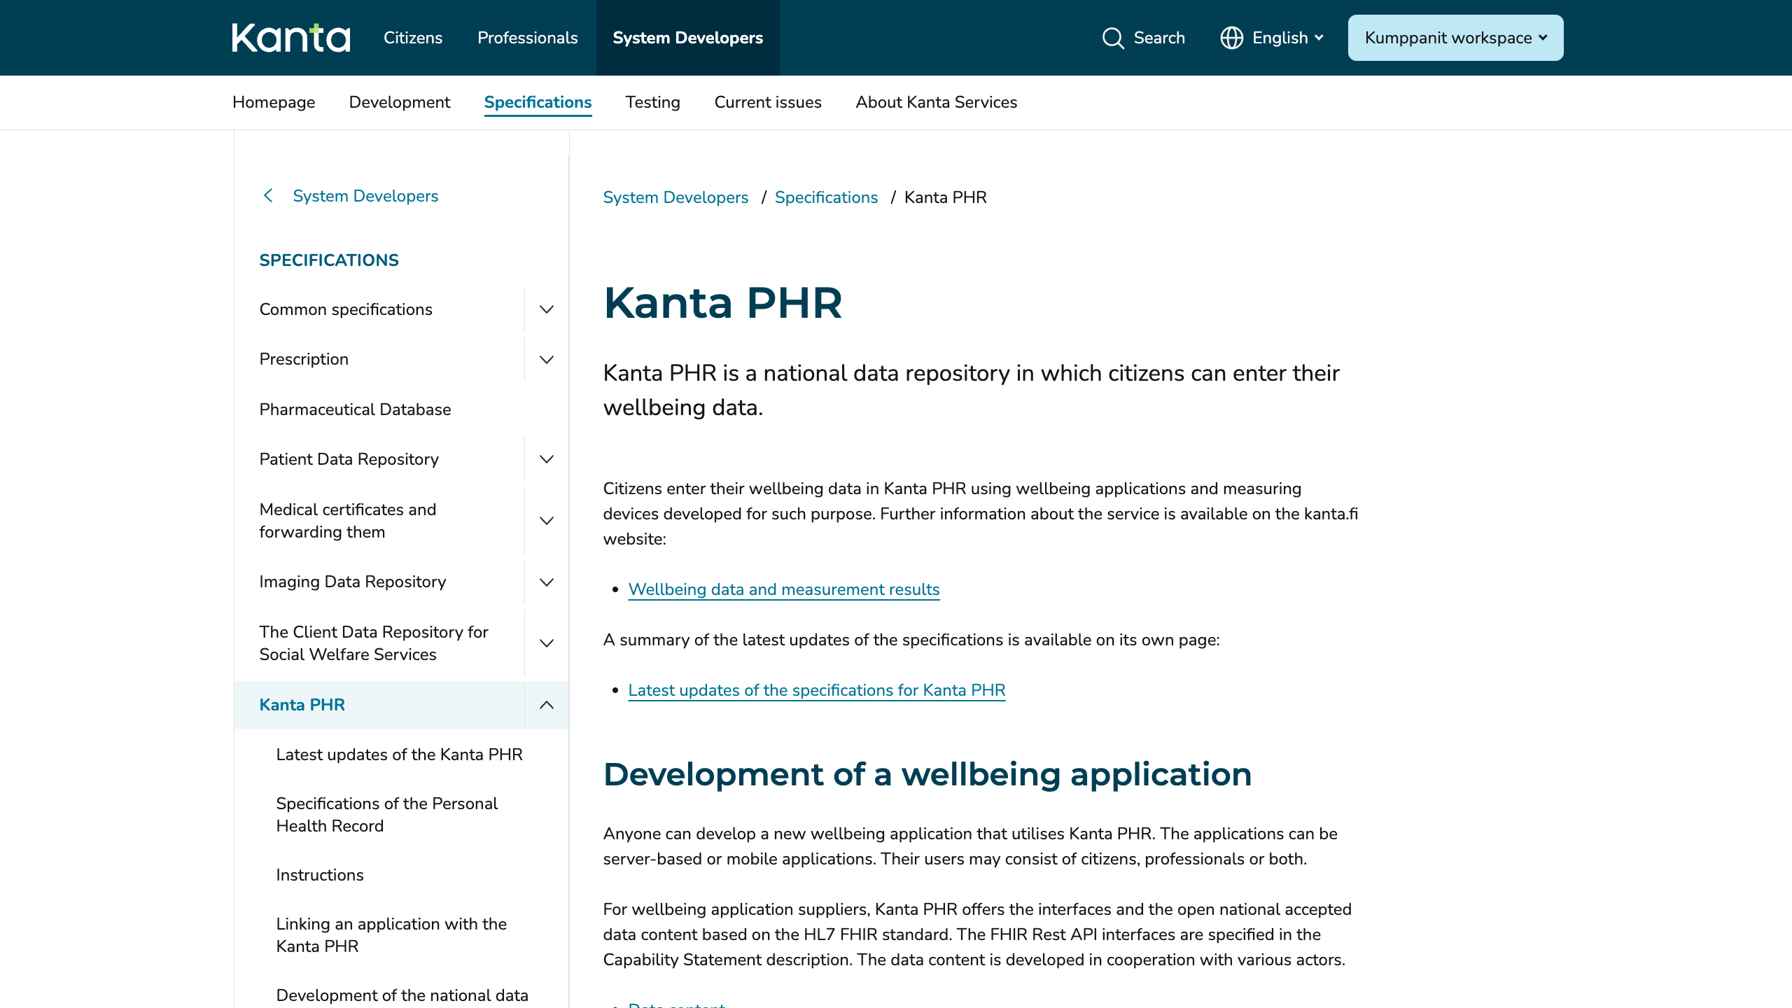
Kanta APIs
Notes:
Patient Access API
Personal Health Record

Slide 28
xShare
Yellow Button
Share your health data in European Electronic Health Record Exchange Format (EEHRxF) with a click-of-a-button
Open Call 2025
Industry Label
Community of Excellence

Slide 29
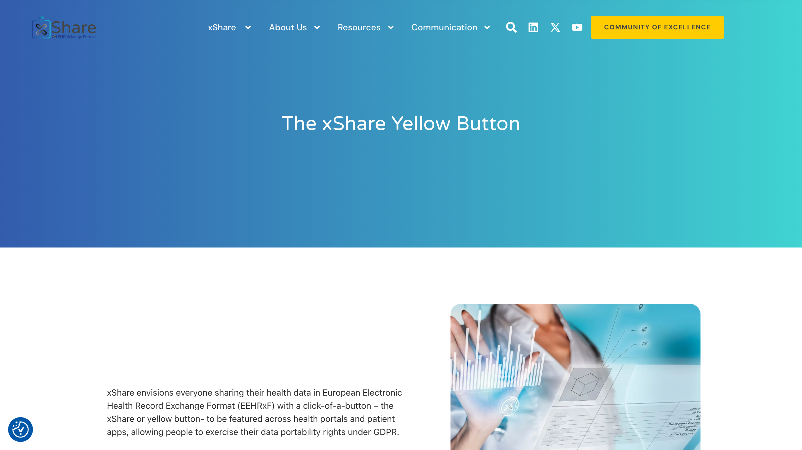
xShare

Slide 30
Digital Identity Wallets, NCP
MyHealth@MyHands
Data chain involving EUDI Wallets, eHealth apps, national contact point infrastructure EU MyHealth@EU OpenNCP, and more
purpose-built for exploration and demonstrations.
https://myhealthmyhands.eu/
MyData Global: Infrastructure Pilot for Wallets
International Patient Summary in the wallet as a credential
Participants: Eyd, Findynet, Sensotrend
Funded by the Nordic Culture Point
Notes:
MyHealth@MyHands
Website
Description
MyData Global
Project description?

Slide 31
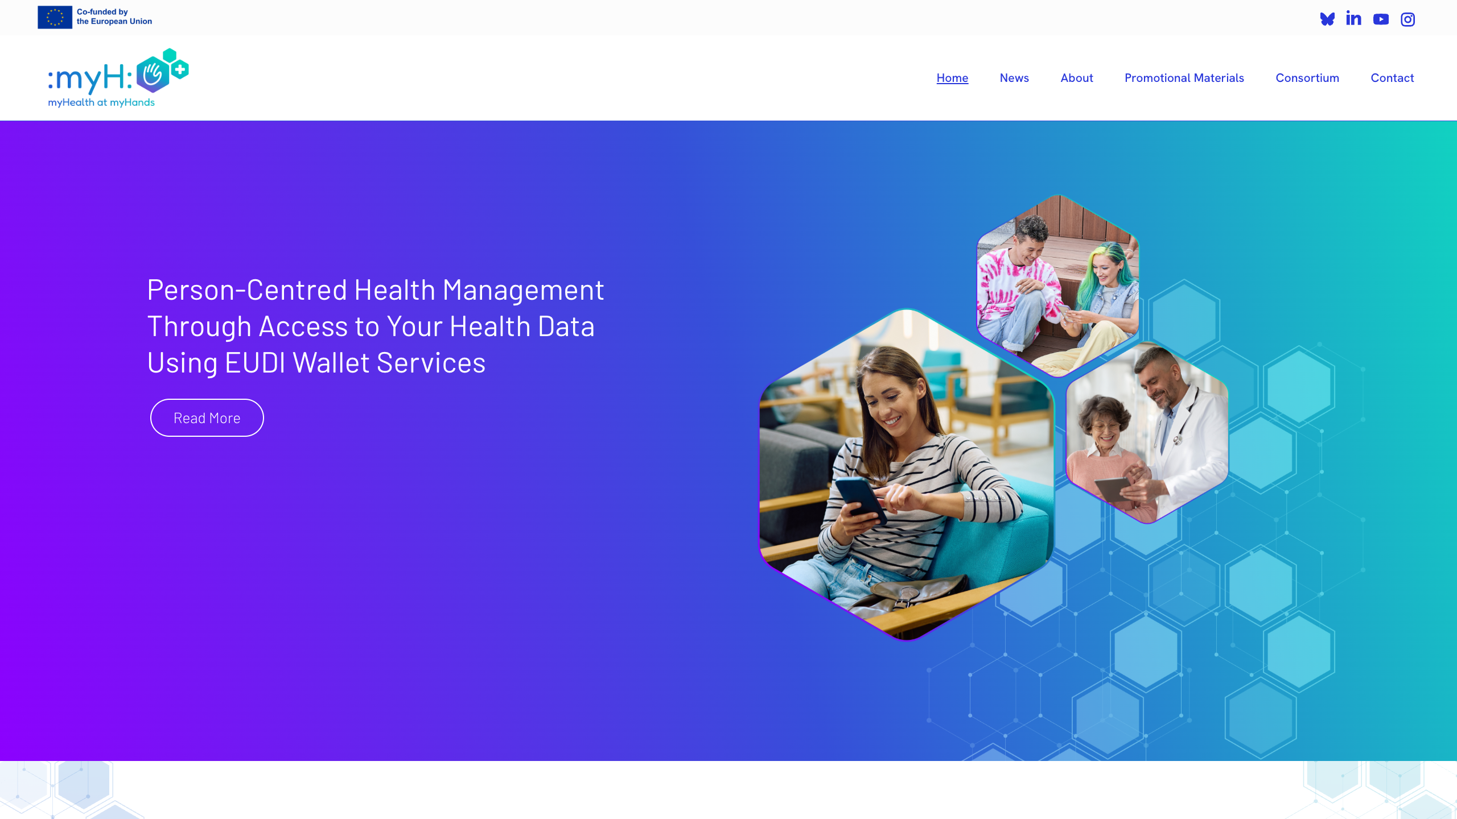
Digital Identity Wallets, NCP

Slide 32
Digital Identity Wallets, NCP
Separate webinar later this week!
Friday, December 19, 2025 at 12:00 EET (11:00 CET)
See hackathon website for details!

Slide 33
Participating
Patient Access track of the Finnish Health Data Hackathon

Slide 34
Participating on the Patient Access Track
Fill in the Google Sheet at https://docs.google.com/spreadsheets/d/1MF02GaMasV3UJtPeZZYTaZ753NqimmJOCHDsZHcktOI/edit?usp=sharing
Share your ideas and interests!

Slide 35
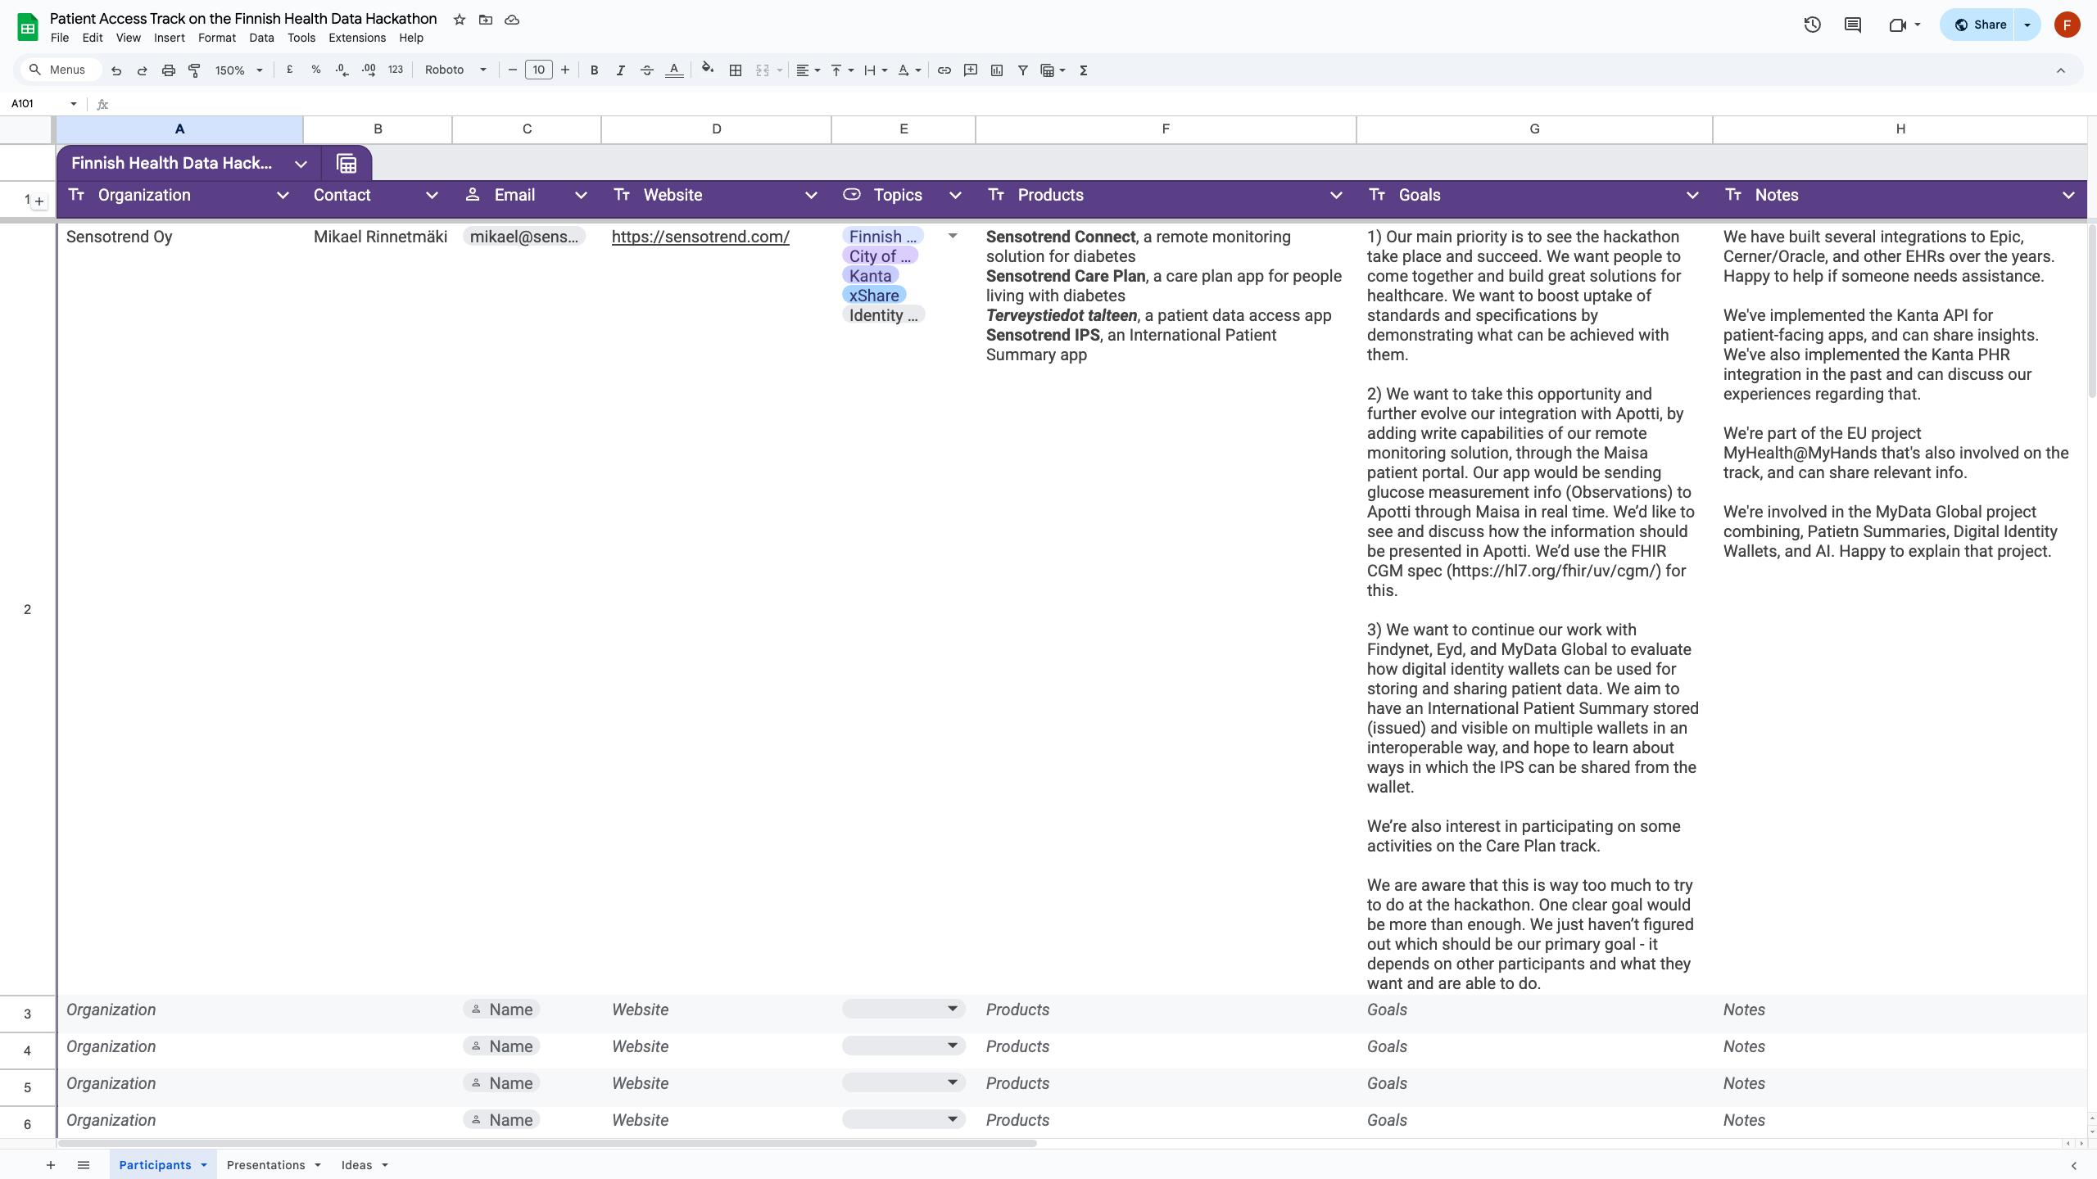

Slide 36
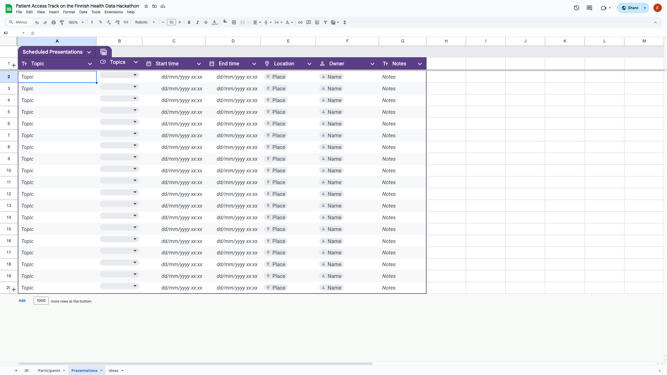

Slide 37
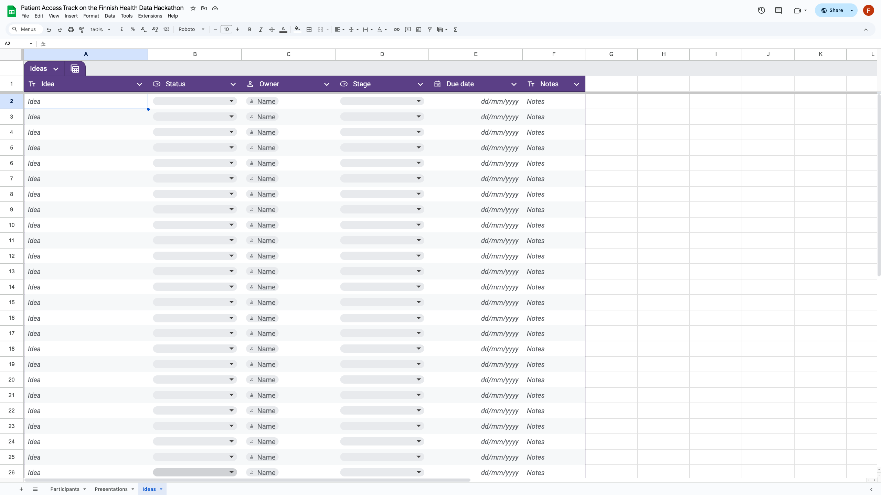

Slide 38
Q&A
Patient Access track of the Finnish Health Data Hackathon

Slide 39
Sponsors

Slide 40
Next Webinars
City of Helsinki / Apotti / Epic
Tuesday, Dec 16, 13:00 CET
Care Plans and Clinical Reasoning
Thursday, December 18, 14:00 CET
Wallets, national contact points (NCP)
Friday, December 19, 11:00 CET

Slide 41
Thank you for participating!

